Slide 1
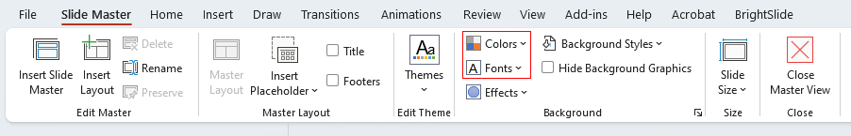
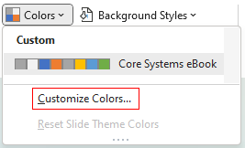


Use this PowerPoint deck as a template to create a custom piece for your brand by adding your logo, fonts, colors, and content.
LOGO PLACEHOLDER
Yellow highlights in the template indicate the areas where text or graphics should be customized for your brand.
How do AI and data analytics benefit retail organizations?
1
Customize your brand fonts and colors in the Slide Master
As a Microsoft partner, we are committed to helping move retail organizations into the digital age, and to enable them to drive sustained profitability and growth through innovative data analytics.
It’s not just a trend ^{[1]}
Recent research by Chain Store Age found that retailers using AI get significant benefits:
2
Update the yellow-highlighted text with your brand-specific copy. Match the surrounding type color by removing the yellow highlight treatment. Adjust the size and display of your fonts to fit the template
71%
of retail respondents said artificial intelligence/machine learning leads their business strategy.
62%
are using AI/ML to predict business performance
61%
are using AI/ML for data analysis
3
Add your custom logo and icons to the slides and slide master. You may change the image to best represent your brand/targeting. If you choose to use the included images, images included in this template must remain for use exclusively in this template, must not be altered or used elsewhere.
56%
are using it as a driver of innovation
52%
are using it both to improve speed and efficiency and to reduce risk in the future
4
Save your final art. Name your file and choose the file destination. Delete the off-slide instructions and any remaining highlighting and use the File pulldown menu to select Export to save as a PDF.
Microsoft’s data solution
A Single Source of Truth
With a unified, governed foundation for centralizing and curating data and analytics workloads from on-prem to clouds, retail organizations can future-
proof their data estate and accelerate the value derived from their data.
Real-Time Insights
Achieve timely insights at enterprise scale, meeting your business intelligence, data warehouse, advanced analytics, data governance, and machine learning objectives with highly secure and cost-effective services.
Personalized Customer Experience
Leverage AI and ML for superior consumer experiences, transforming customer journeys, providing personalized offerings, and building meaningful relationships.
Resilient Retail
Achieve resilient retail by leveraging managed databases, analytics services, and AI offerings, streamlining data integration and management to allow more focus on creating value.
8 ways that AI can be used to improve the customer experience ^{[2]}
Reply to customers faster, with localized, on-brand messaging
Reach customers in new, native ways online
Create a ChatGPT like experience tailored to your own enterprise data
Revolutionize your site’s search engine, with rich semantic search experiences
Make faster, more informed decisions on where to invest in e-commerce improvements with accessible analytics
Experiment with automating content generation at scale, speeding up the writing and image generation processes
Democratize data for non-technical employees to make real-time and predictive optimizations
Drive better engagement with product detail page content creation
Next steps
We’d love to engage with you to find out what your vision is for your organization going forward. As a Microsoft parner, we have the expertise and resources to advise and assist you in driving transformation in your retail organization. We can help you take advantage of Microsoft data and analytics solutions so you can transform business operations and provide exceptional shopping experiences for consumers.
[Placeholder for partner URL]
[Placeholder for partner phone]
[Placeholder for partner URL]
Chain Store Age, Colman Parkes Research 2023
What's my generative AI strategy?, Microsoft industry blog 2023

